Slide 1

Alphastar
A StarCraft 2 AI by Google’s Deepmind

Slide 2

What is StarCraft 2 - Intro

Slide 3
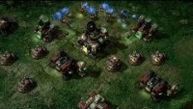
What is StarCraft 2 – Gameplay

Slide 4
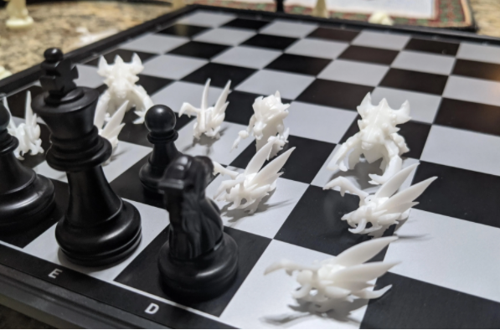

Slide 5
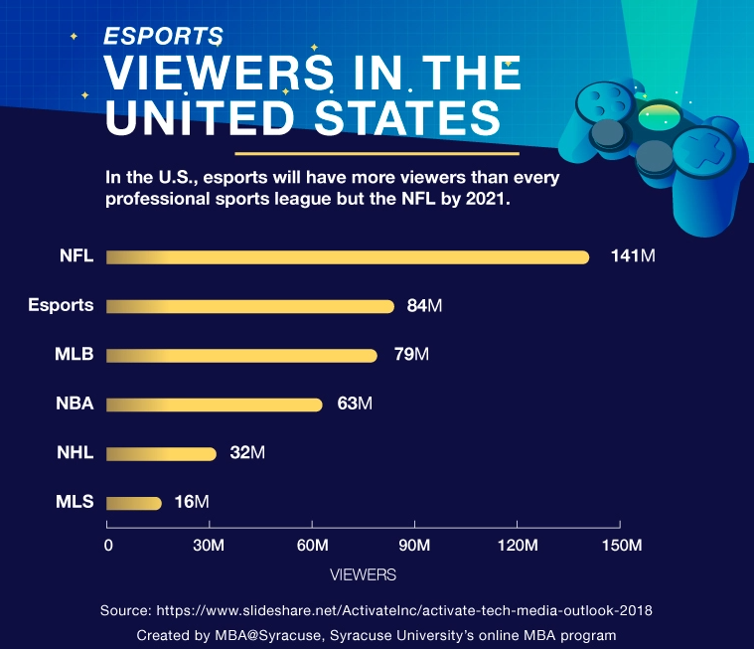
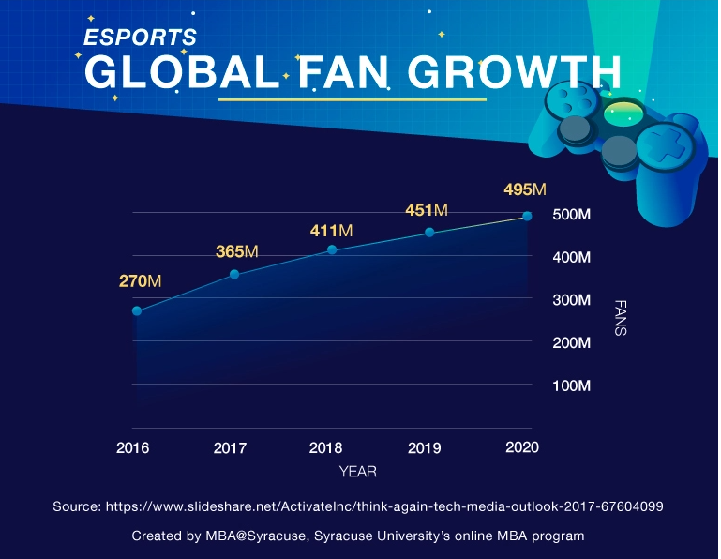
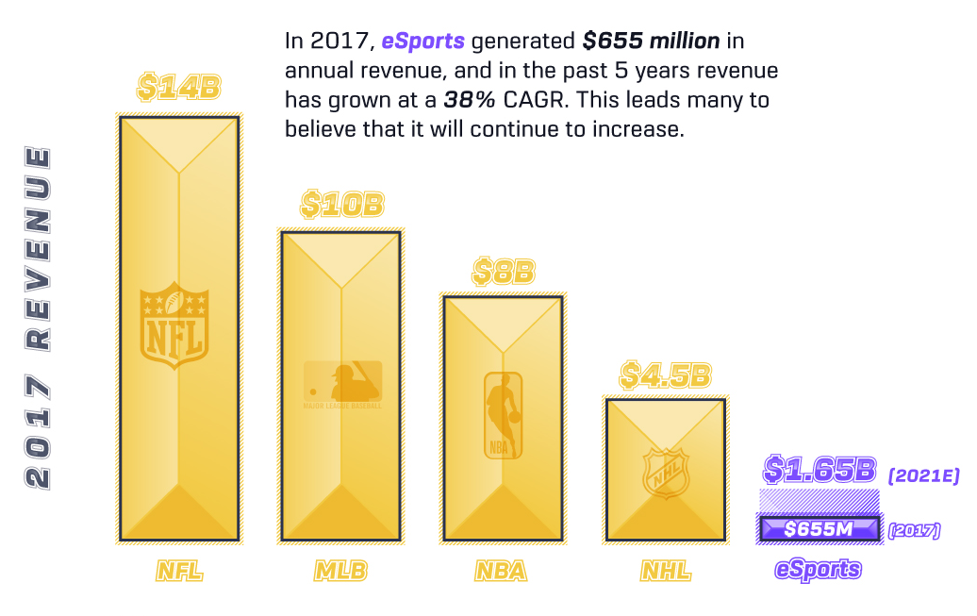
eSports is a Thing

Slide 6
Why StarCraft II?
The need to balance short and long-term goals and adapt to unexpected situations, poses a huge challenge for systems that have often tended to be brittle and inflexible.
Game theory: Like rock-paper-scissors, there is no single best strategy. An AI training process needs to continually explore and expand the frontiers of strategic knowledge.
Imperfect information: Unlike games like chess or Go where players see everything, crucial information is hidden from a StarCraft player and must be actively discovered by “scouting”.
Long term planning: Like many real-world problems cause-and-effect is not instantaneous. Games can also take anywhere up to one hour to complete, meaning actions taken early in the game may not pay off for a long time.
Real time: Unlike traditional board games where players alternate turns between subsequent moves, StarCraft players must perform actions continually as the game clock progresses.
Large action space: Hundreds of different units and buildings must be controlled at once, in real-time, resulting in a combinatorial space of possibilities. On top of this, actions are hierarchical and can be modified and augmented. Our parameterization of the game has an average of approximately 10 to the 26 legal actions at every time-step.

Slide 7
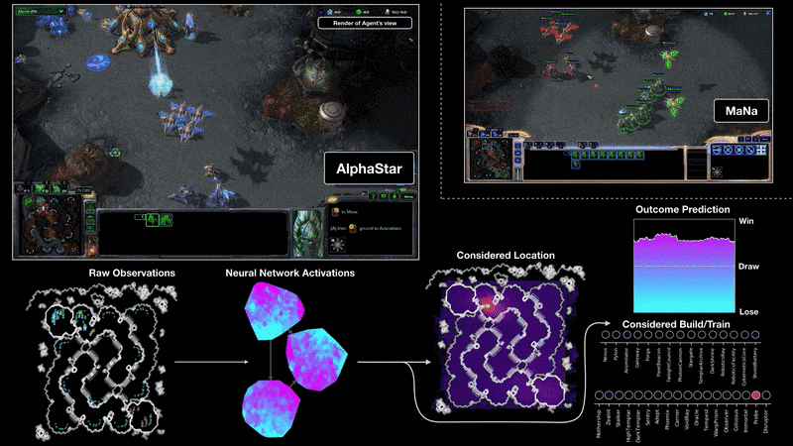

Slide 8
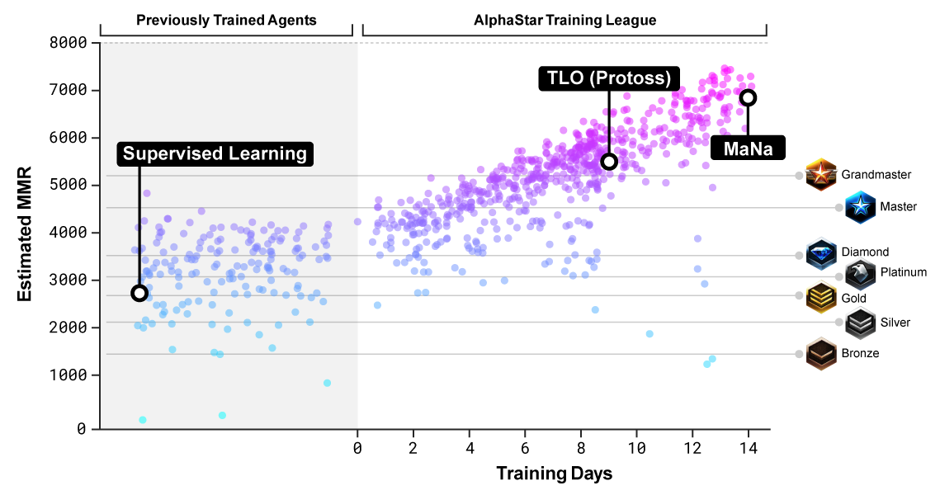

Slide 9
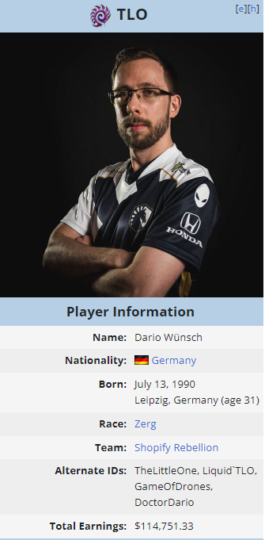
0-5

Slide 10
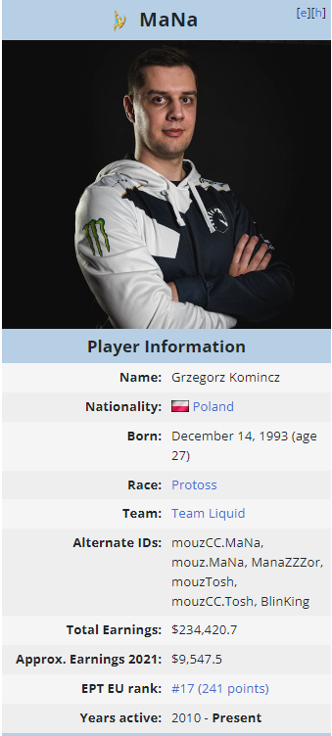
0-5

Slide 11
Conclusion
Best Slide
Much WoW

